Slide 1

Session 16
Encrypting and Decrypting Data

Slide 2
Objectives
Explain symmetric encryption.
Explain asymmetric encryption.
List the various types in the System.Security.Cryptography namespace that supports symmetric and asymmetric encryptions.
‹#›

Slide 3

Introducing Cryptography and Encryption 1-2
All organizations need to handle sensitive data.
This data can be either present in storage or may be exchanged between different entities within and outside the organization over a network.
Steve is the CEO of a company.
Steve while travelling needs to access performance appraisal reports of the top management of the company.
These reports contain data that are confidential and are stored in the company’s server.
Such data is often prone to misuse either intentionally with malicious intent or unintentionally.
To avoid such misuse, there should be some security mechanism that can ensure confidentiality and integrity of data.
Example

Slide 4


Introducing Cryptography and Encryption 2-2
Cryptography is a security mechanism to ensure data confidentiality and integrity.
The commonly used ways to secure sensitive data is through encryption.

Slide 5
Encryption Basics 1-2
The primary objective of cryptography is to secure data exchanged between entities, each of which can be a person or an application.
Consider a scenario:
User A transmits sensitive data to User B.
The transmission needs to be confidential to ensure that even if a third party obtains the data, the data is incomprehensible.
User B before using the data must be sure about the integrity of the data, which means that User B must be sure that the data has not been modified in transit.
User B must be able to authenticate that the data is actually been sent by User A.
After sending the data, User A must not be able to deny sending the data to User B.
Encryption:
Is a cryptographic technique that ensures data confidentiality.
Converts data in plain text to cipher (secretly coded) text.
The opposite process of encryption is called decryption, which is a process that converts the encrypted cipher text back to the original plain text.
Example

Slide 6
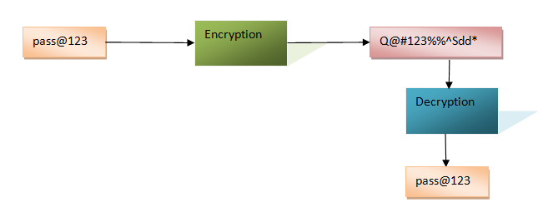
Encryption Basics 2-2
The following figure shows the process of encryption and decryption of a password as an example.
In the figure:
The plain text,pass@123 is encrypted to a cipher text.
The cipher text is decrypted back to the original plain text.
‹#›

Slide 7
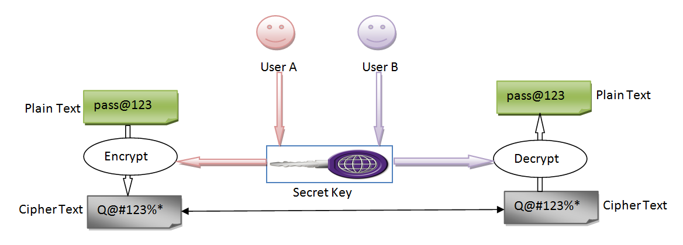
Symmetric Encryption 1-2
Symmetric encryption, or secret key encryption, uses a single key, known as the secret key both to encrypt and decrypt data.
The following figure shows the symmetric encryption and decryption process.

Slide 8
Symmetric Encryption 2-2
The following steps outline an example usage of symmetric encryption:
User A uses a secret key to encrypt a plain text to cipher text.
User A shares the cipher text and the secret key with User B.
User B uses the secret key to decrypt the cipher text back to the original plain text.

Slide 9
Asymmetric Encryption 2-2
The following steps outline an example usage of asymmetric encryption:
User A generates a public and private key pair.
User A shares the public key with User B.
User B uses the public key to encrypt a plain text to cipher text.
User A uses the private key to decrypt the cipher text back to the original plain text.
‹#›

Slide 10
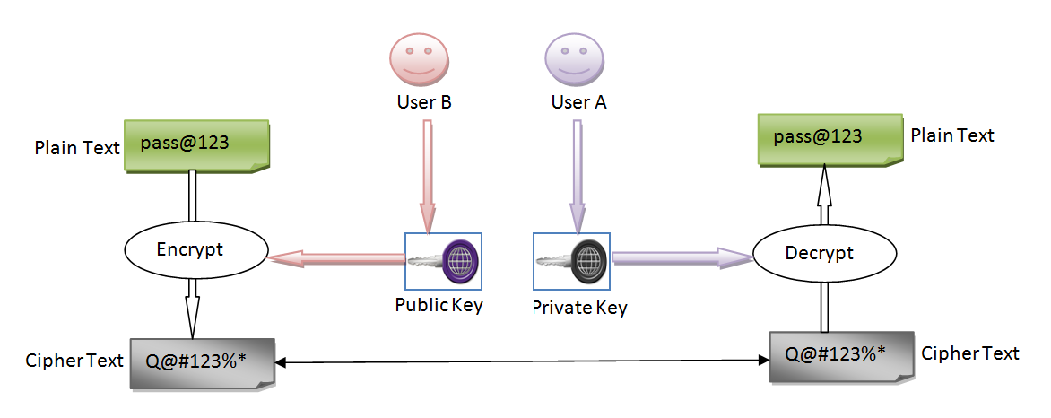
Asymmetric Encryption 1-2
Asymmetric encryption uses a pair of public and private key to encrypt and decrypt data.
The following figure shows the symmetric encryption and decryption process.
‹#›

Slide 11
Symmetric Encryption Algorithms 1-6
The System.Security.Cryptography namespace provides the SymmetricAlgorithm base class for all symmetric algorithm classes.
The derived classes of the SymmetricAlgorithm base class are as follows:
RC2
DES
TripleDES
Aes
Rijndael
‹#›

Slide 12
Symmetric Encryption Algorithms 2-6
Is an abstract base class for all classes that implement the RC2 algorithm.
Is a proprietary algorithm developed by RSA Data Security, Inc in 1987.
Supports key sizes ranging from 40 bits to 128 bits in 8-bit increments for encryption.
Was designed for the old generation processors and currently have been replaced by more faster and secure algorithms.
Derives the RC2CryptoServiceProvider class to provide an implementation of the RC2 algorithm.
RC2

Slide 13
Symmetric Encryption Algorithms 3-6
DES
Is an abstract base class for all classes that implement the Data Encryption Standard (DES) algorithm.
Developed by IBM but as of today available as a U.S. Government Federal Information Processing Standard (FIPS 46-3).
Works on the data to encrypt as blocks where each block is of 64 bits.
Uses a key of 64 bits to perform the encryption. On account of its small key size DES encrypts data faster as compared to other asymmetric algorithms.
Is prone to brute force security attacks because of its smaller key size.
Derives the DESCryptoServicerProvider class to provide an implementation of the DES algorithm.
‹#›

Slide 14
Symmetric Encryption Algorithms 4-6
TripleDES
Is an abstract base class for all the classes that implement the TripleDES algorithm.
Is an enhancement to the DES algorithm for the purpose of making the DES algorithm more secured against security threats.
Works on 64 bit blocks that is similar to the DES algorithm.
Supports key sizes of 128 bits to 192 bits.
Derives the TripleDESCryptoServiceProvider class to provide an implementation of the TripleDES algorithm.
‹#›

Slide 15
Symmetric Encryption Algorithms 5-6
Aes
Is an abstract base class for all classes that implement the Advanced Encryption Standard (AES) algorithm.
Is a successor of DES and is currently considered as one of the most secure algorithm.
Is more efficient in encrypting large volume of data in the size of several gigabytes.
Works on 128-bits blocks of data and key sizes of 128, 192, or 256 bits for encryption.
Derives the AesCryptoServiceProvider and AesManaged classes to provide an implementation of the AES algorithm.
‹#›

Slide 16
Symmetric Encryption Algorithms 6-6
Rijndael
Is an abstract base class for all the classes that implement the Rijndael algorithm.
Is a superset of the Aes algorithm.
Supports key sizes of 128, 192, or 256 bits similar to the Aes algorithm.
Can have block sizes of 128, 192, or 256 bits, unlike Aes, which has a fixed block size of 128 bits.
Provides the flexibility to select an appropriate block size based on the volume of data to encrypt by supporting different block sizes.
Derives the RijndealManaged class to provide an implementation of the Rijndeal algorithm.
‹#›

Slide 17
Asymmetric Encryption Algorithm 1-2
The System.Security.Cryptography namespace provides the AsymmetricAlgorithm base class for all asymmetric algorithm classes.
RSA is an abstract class that derives from the AsymmetricAlgorithm class.
The RSA class is the base class for all the classes that implement the RSA algorithm.
The RSA algorithm was designed in 1977 by Ron Rivest, Adi Shamir, and Leonard Adleman and till now is the most widely adopted algorithm to perform asymmetric encryption and decryption.
This algorithm functions in three steps: key generation, encryption, and decryption.
‹#›

Slide 18
Asymmetric Encryption Algorithm 2-2
The RSA algorithm generates a public key as a product of two large prime numbers, along with a public (or encryption) value.
The algorithm generates a private key as a product of the same two large prime numbers, along with a private (or decryption) value.
The public key is used to perform encryption while the private key is used to perform decryption.
In the .NET Framework, the RSACryptoServiceProvider class derives from the RSA class to provide an implementation of the RSA algorithm.
‹#›

Slide 19

Performing Symmetric Encryption
You need to use one of the symmetric encryption implementation classes of the .NET Framework to perform symmetric encryption.
The first step to perform symmetric encryption is to create the symmetric key.
‹#›

Slide 20
Generating Symmetric Keys 1-4
When you use the default constructor of the symmetric encryption classes, such as RijndaelManaged and AesManaged, a key and IV are automatically generated.
The generated key and the IV can be accessed as byte arrays using the Key and IV properties of the encryption class.
The following code creates a symmetric key and IV using the RijndaelManaged class.
Snippet
using System;
using System.Security.Cryptography;
using System.Text;
. . .
. . .
RijndaelManagedsymAlgo = new RijndaelManaged();
Console.WriteLine("Generated key: {0}, \nGenerated IV: {1}",
Encoding.Default.GetString(symAlgo.Key), Encoding.Default.GetString(symAlgo.IV));

Slide 21
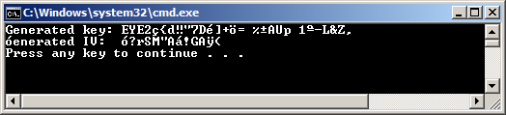
Generating Symmetric Keys 2-4
The code snippet uses the default constructor of the RijndaelManaged class to generate a symmetric key and IV.
The Key and IV properties are accessed and printed as strings using the default encoding to the console.
The following figure shows the output of the code.
Output
‹#›

Slide 22
Generating Symmetric Keys 3-4
The symmetric encryption classes, such as RijndaelManaged also provide the GenerateKey()and GenerateIV() methods that you can use to generate keys and IVs, as shown in the following code:
Snippet
using System;
using System.Security.Cryptography;
using System.Text;
. . .
. . .
RijndaelManagedsymAlgo = new RijndaelManaged();
symAlgo.GenerateKey();
symAlgo.GenerateIV();
byte[] generatedKey = symAlgo.Key;
byte[] generatedIV =symAlgo.IV;
Console.WriteLine("Generated key through GenerateKey(): {0}, \nGenerated IV through
GenerateIV(): {1}", Encoding.Default.GetString(generatedKey),
Encoding.Default.GetString(generatedIV));
‹#›

Slide 23
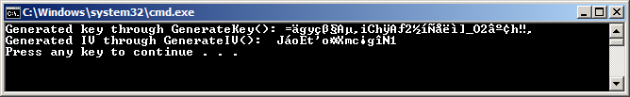
Generating Symmetric Keys 4-4
In the code:
An RijndaelManaged object is created and the GenerateKey() and GenerateIV() methods are called to generate a key and an IV.
The Key and the IV properties are then accessed and printed as strings using the default encoding to the console.
The following figure shows the output of the code.
Output

Slide 24
Encrypting Data 1-5
The symmetric encryption classes of the .NET Framework provides the CreateEncryptor() method that returns an object of the ICryptoTransform interface.
The ICryptoTransform object is responsible for transforming the data based on the algorithm of the encryption class.
Once you have obtained an ICryptoTransform object, you can use the CryptoStream class to perform encryption.
The CryptoStream class acts as a wrapper of a stream-derived class, such as FileStream, MemoryStream, and NetworkStream.
‹#›

Slide 25
Encrypting Data 2-5
The CryptoStream class acts as a wrapper of a stream-derived class, such as FileStream, MemoryStream, and NetworkStream.
A CryptoStream object operates in one of the following two modes defined by the CryptoStreamMode enumeration:
Write:
This mode allows write operation on the underlying stream.
Use this mode to perform encryption.
Read:
This mode allows read operation on the underlying stream.
Use this mode to perform decryption.

Slide 26
Encrypting Data 3-5
You can create a CryptoStream object by calling the constructor that accepts the following three parameters:
The underlying stream object
The ICryptoTransform object
The mode defined by the CryptoStreamMode enumeration
After creating the CryptoStreamobject you can call the Write() method to write the encrypted data to the underlying stream.
The following code encrypts data using the RijndaelManaged class and writes the encrypted data to a file.
Snippet
using System;
using System.IO;
using System.Security.Cryptography;
using System.Text;
class SymmetricEncryptionDemo
{
static void EncryptData(String plainText, RijndaelManaged algo)
{
byte[] plainDataArray = ASCIIEncoding.ASCII.GetBytes(plainText);
‹#›

Slide 27
Encrypting Data 4-5
ICryptoTransform transform=algo.CreateEncryptor();
using (var fileStream = new FileStream("D:\\CipherText.txt",
FileMode.OpenOrCreate, FileAccess.Write))
{
using (var cryptoStream = new CryptoStream(fileStream, transform,
CryptoStreamMode.Write))
{
cryptoStream.Write(plainDataArray, 0,
plainDataArray.GetLength(0));
Console.WriteLine("Encrypted data written to:
D:\\CipherText.txt");
}
}
}
static void Main()
{
RijndaelManaged symAlgo = new RijndaelManaged();
Console.WriteLine("Enter data to encrypt.");
string dataToEncrypt = Console.ReadLine();
EncryptData(dataToEncrypt, symAlgo);
}
}
‹#›

Slide 28
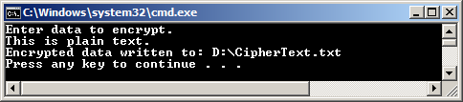
Encrypting Data 5-5
In the code:
The Main() method creates a RijndaelManaged object and passes it along with the data to encrypt to the EncryptData() method.
The call to the CreateEncryptor() method creates the ICryptoTransform object in the EncryptData() method.
Then, a FileStream object is created to write the encrypted text to the CipherText.txt file.
The CryptoStream object is created and its Write() method is called.
The following figure shows the output of the code.
Output
‹#›

Slide 29
Decrypting Data 1-4
To decrypt data, you need to:
The code creates a program that performs both encryption and decryption.
Use the same symmetric encryption class, key, and IV used for encrypting the data.
Step 1
Call the CreateDecryptor() method to obtain a ICryptoTransform object that will perform the transformation.
Step 2
Create the CryptoStream object in Read mode and initialize a StreamReader object with the CryptoStream object.
Step 3
Call the ReadToEnd() method of the StreamReader that returns the decrypted text as a string.
Step 4
‹#›

Slide 30
Decrypting Data 2-4
Snippet
using System;
using System.IO;
using System.Security.Cryptography;
using System.Text;
class SymmetricEncryptionDemo
{
static void EncryptData(String plainText, RijndaelManaged algo)
{
byte[] plainDataArray = ASCIIEncoding.ASCII.GetBytes(plainText);
ICryptoTransform transform = algo.CreateEncryptor();
using (var fileStream = new FileStream("D:\\CipherText.txt", FileMode.OpenOrCreate, FileAccess.Write))
{
using (var cryptoStream = new CryptoStream(fileStream, transform, CryptoStreamMode.Write))
{
cryptoStream.Write(plainDataArray, 0, plainDataArray.GetLength(0));
Console.WriteLine("Encrypted data written to: D:\\CipherText.txt");
}
}
}
static void DecryptData(RijndaelManaged algo)
{
‹#›

Slide 31
Decrypting Data 3-4
ICryptoTransform transform = algo.CreateDecryptor();
using (var fileStream = new FileStream("D:\\CipherText.txt", FileMode.Open, FileAccess.Read))
{
using (CryptoStream cryptoStream = new CryptoStream(fileStream, transform, CryptoStreamMode.Read))
{
using (var streamReader = new StreamReader(cryptoStream))
{
string decryptedData = streamReader.ReadToEnd();
Console.WriteLine("Decrypted data: \n{0}", decryptedData);
}
}
}
}
static void Main()
{
RijndaelManaged symAlgo = new RijndaelManaged();
Console.WriteLine("Enter data to encrypt.");
string dataToEncrypt = Console.ReadLine();
EncryptData(dataToEncrypt, symAlgo);
DecryptData(symAlgo);
}
}
‹#›

Slide 32
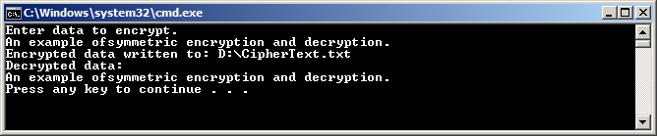
Decrypting Data 4-4
In the code:
The Main() method creates a RijndaelManaged object and passes it along with the data to encrypt the EncryptData() method.
The encrypted data is saved to the CipherText.txt file.
The Main() method calls the DecryptData() method passing the same RijndaelManaged object created for encryption.
The DecryptData() method creates the ICryptoTransformobject and uses a FileStream object to read the encrypted data from the file.
The CryptoStream object is created in the Read mode initialized with the FileStream and ICryptoTransformobjects.
A StreamReader object is created by passing the CryptoStream object to the constructor.
The ReadToEnd() method of the StreamReader object is called.
The decrypted text returned by the ReadToEnd() method is printed to the console, as shown in the following figure:
Output
‹#›

Slide 33
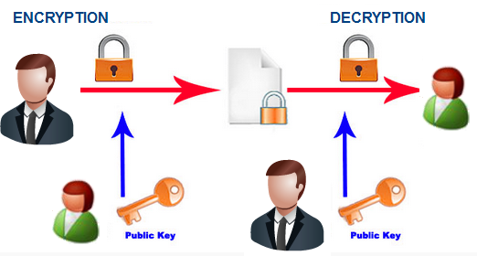
Performing Asymmetric Encryption
You can use the RSACryptoServiceProvider class of the System.Security.Cryptography namespace to perform asymmetric encryption.
‹#›

Slide 34
Generating Asymmetric Keys 1-2
When you call the default constructor of the RSACryptoServiceProvider class, a new public/private key pair is automatically generated.
After you create a new instance of the class, you can export the key information by using one of the following methods:
ToXMLString()
Returns an XML representation of the key information.
ExportParameters()
Returns an RSAParameters structure that holds the key information.
Accept a Boolean value by both the ToXMLString() and ExportParameters() methods.
A false value indicates that the method should return only the public key information while a true value indicates that the method should return information of both the public and private keys.
‹#›

Slide 35
Generating Asymmetric Keys 2-2
The following code shows how to create and initialize an RSACryptoServiceProvider object and then export the public key in XML format:
The following code shows how to create and initialize an RSACryptoServiceProvider object and then export both the public and private keys as an RSAParameters structure:
Snippet
using System;
using System.Security.Cryptography;
using System.Text;
. . .
RSACryptoServiceProviderrSAKeyGenerator = new RSACryptoServiceProvider();
string publicKey = rSAKeyGenerator.ToXmlString(false);
}
Snippet
using System;
using System.Security.Cryptography;
using System.Text;
. . .
RSACryptoServiceProviderrSAKeyGenerator = new RSACryptoServiceProvider();
RSAParametersrSAKeyInfo = rSAKeyGenerator.ExportParameters(true);
‹#›

Slide 36
Key Containers 1-3
Private keys used to decrypt data in asymmetric encryption should be stored using a secured mechanism.
To achieve this, you can use a key container that is a logical structure to securely store asymmetric keys.
The .NET Framework provides the CspParameters class to create a key container and to add and remove keys to and from the container.
To create a key container for an RSACryptoServiceProvider object:
Use the default constructor of the CspParameters class to create a key container instance.
Set the container name using the KeyContainerName property of the CspParameters class.
Pass the CspParameters object to the constructor while creating the RSACryptoServiceProvider object to store the key pair in the key container.
‹#›

Slide 37
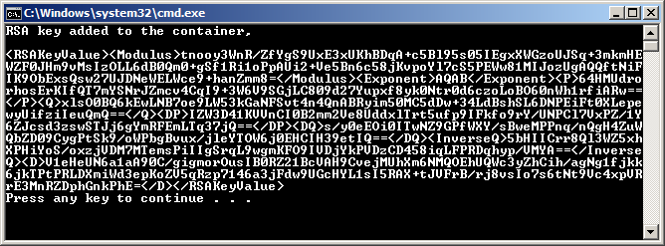
Key Containers 2-3
The following code uses a key container to store a key pair:
The following figure shows the output of the code:
Snippet
using System;
using System.Security.Cryptography;
using System.Text;
...
CspParameterscspParams = new CspParameters();cspParams.KeyContainerName = "RSA_CONTAINER";RSACryptoServiceProviderrSAKeyGenerator = newRSACryptoServiceProvider(cspParams);Console.WriteLine("RSA key added to the container,\n\n{0}", rSAKeyGenerator.ToXmlString(true));
Output
‹#›

Slide 38
Key Containers 3-3
To retrieve a key pair from the container:
Create a new object of the CspParameters class and initialize it with the name of the key container that contains the key pair.
Create a new object of the RSACryptoServiceProvider initialized with the CspParameters object.
The RSACryptoServiceProvider object will now contain the keys stored in the key container.
The following code retrieves keys from the key container, named RSA_CONTAINER:
Snippet
using System;
using System.Security.Cryptography;
using System.Text;
. . .
CspParameterscp = new CspParameters();
cp.KeyContainerName = "RSA_CONTAINER";
RSACryptoServiceProviderrsaEncryptor = new RSACryptoServiceProvider(cp);
‹#›

Slide 39
Encrypting Data 1-3
To encrypt data, you need to:
Create a new instance of the RSACryptoServiceProvider class
Call the ImportParameters() method to initialize the instance with the public key information exported to an RSAParameters structure.
The following code shows how to initialize an RSACryptoServiceProvider object with the public key exported to an RSAParameters structure:
Snippet
using System;
using System.Security.Cryptography;
using System.Text;
. . .
. . .
RSACryptoServiceProviderrSAKeyGenerator = new
RSACryptoServiceProvider();
RSAParametersrSAKeyInfo = rSAKeyGenerator.ExportParameters(false);
RSACryptoServiceProviderrsaEncryptor= new
RSACryptoServiceProvider();
rsaEncryptor.ImportParameters(rSAKeyInfo);
‹#›

Slide 40
Encrypting Data 2-3
If the public key information is exported to XML format, you need to call the FromXmlString()method to initialize the RSACryptoServiceProvider object with the public key, as shown in the following code:
Snippet
using System;
using System.Security.Cryptography;
using System.Text;
. . .
RSACryptoServiceProviderrSAKeyGenerator = new
RSACryptoServiceProvider();
string publicKey = rSAKeyGenerator.ToXmlString(false);
RSACryptoServiceProviderrsaEncryptor= new RSACryptoServiceProvider();
rsaEncryptor.FromXmlString(publicKey);
‹#›

Slide 41
Encrypting Data 3-3
After the RSACryptoServiceProvider object is initialized with the public key, you can encrypt data by calling the Encrypt() method of the RSACryptoServiceProvider class.
The Encrypt() method accepts the following two parameters:
byte array of the data to encrypt
A Boolean value (It indicates whether or not to perform encryption using Optimal Asymmetric Encryption Padding (OAEP) padding. A true value uses OAEP padding while a false value uses PKCS#1 v1.5 padding.)
The Encrypt() method after performing encryption returns a byte array of the encrypted text, as shown in the code:
Snippet
byte[] plainbytes = new UnicodeEncoding().GetBytes("Plain text to encrypt.");
byte[] cipherbytes = rsaEncryptor.Encrypt(plainbytes, true);
‹#›

Slide 42



Decrypting Data 1-8
To decrypt data, you need to initialize an RSACryptoServiceProvider object using the private key of the key pair whose public key was used for encryption.
The following code shows how to initialize an RSACryptoServiceProvider object with the private key exported to an RSAParameters structure:
Snippet
RSACryptoServiceProviderrSAKeyGenerator = new
RSACryptoServiceProvider();
RSAParametersrSAKeyInfo = rSAKeyGenerator.ExportParameters(true);
RSACryptoServiceProviderrsaDecryptor= new RSACryptoServiceProvider();
rsaDecryptor.ImportParameters(rSAKeyInfo);
‹#›

Slide 43
Decrypting Data 2-8
The following code shows how to initialize an RSACryptoServiceProvider object with the private key exported to XML format:
Snippet
RSACryptoServiceProviderrSAKeyGenerator = new
RSACryptoServiceProvider();
string keyPair = rSAKeyGenerator.ToXmlString(true);
RSACryptoServiceProviderrsaDecryptor = new
RSACryptoServiceProvider();
rsaDecryptor.FromXmlString(keyPair);
‹#›

Slide 44
Decrypting Data 3-8
When the RSACryptoServiceProvider object is initialized with the private key, you can decrypt data by calling the Decrypt() method of the RSACryptoServiceProvider class.
The Decrypt() method accepts the following two parameters:
byte array of the encrypted data
A Boolean value (It indicates whether or not to perform encryption using OAEP padding. A true value uses OAEP padding while a false value uses PKCS#1 v1.5 padding.)

Slide 45
Decrypting Data 4-8
The Decrypt() method returns a byte array of the original data, as shown in the following code:
The following code shows a program that performs asymmetric encryption and decryption:
Snippet
byte[] plainbytes = rsaDecryptor.Decrypt(cipherbytes, false);
Snippet
using System;
using System.IO;
usingSystem.Security.Cryptography;
usingSystem.Text;
classAsymmetricEncryptionDemo
{
‹#›

Slide 46
Decrypting Data 5-8
static byte[] EncryptData(string plainText, RSAParameters
rsaParameters)
{
byte[] plainTextArray = new
UnicodeEncoding().GetBytes(plainText);
RSACryptoServiceProvider RSA = new RSACryptoServiceProvider();
RSA.ImportParameters(rsaParameters);
byte[] encryptedData = RSA.Encrypt(plainTextArray,true);
return encryptedData;
}
static byte[] DecryptData(byte[] encryptedData, RSAParameters
rsaParameters)
{
RSACryptoServiceProvider RSA = new
RSACryptoServiceProvider();
RSA.ImportParameters(rsaParameters);
byte[] decryptedData = RSA.Decrypt(encryptedData,true);
returndecryptedData;
‹#›

Slide 47
Decrypting Data 6-8
}
static void Main(string[] args)
{
Console.WriteLine("Enter text to encrypt:");
String inputText = Console.ReadLine();
RSACryptoServiceProvider RSA = new RSACryptoServiceProvider();
RSAParametersRSAParam=RSA.ExportParameters(false);
byte[] encryptedData = EncryptData(inputText, RSAParam);
stringencryptedString = Encoding.Default.GetString(encryptedData);
Console.WriteLine("\nEncrypted data \n{0}",encryptedString);
byte[] decryptedData = DecryptData(encryptedData,
RSA.ExportParameters(true));
StringdecryptedString = new
UnicodeEncoding().GetString(decryptedData);
Console.WriteLine("\nDecrypted data \n{0}", decryptedString);
}
}
‹#›

Slide 48
Decrypting Data 7-8
In the code:
The Main() method creates a RSACryptoServiceProvider object and exports the public key as a RSAParameters structure.
The EncryptData() method is then called passing the user entered plain text and the RSAParameters object.
The EncryptData() method uses the exported public key to encrypt the data and returns the encrypted data as a byte array.
The Main() method then exports both the public and private key of the RSACryptoServiceProvider object into a second RSAParameters object.
The DecryptData() method is called passing the encrypted byte array and the RSAParameters object.
The DecryptData() method performs the decryption and returns the original plain text as a string.
‹#›

Slide 49
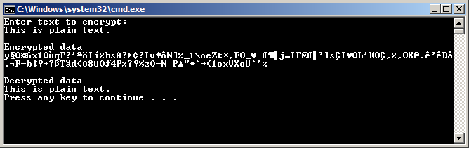
Decrypting Data 8-8
The following figure shows the output of the code.
Output
‹#›

Slide 50
Summary
Encryption is a security mechanism that converts data in plain text to cipher text.
An encryption key is a piece of information or parameter that determines how a particular encryption mechanism works.
The .NET Framework provides various types in the System.Security.Cryptography namespace to support symmetric and asymmetric encryptions.
When you use the default constructor to create an object of the symmetric encryption classes, a key and IV are automatically generated.
The ICryptoTransform object is responsible for transforming the data based on the algorithm of the encryption class.
The CryptoStream class acts as a wrapper of a stream-derived class, such as FileStream, MemoryStream, and NetworkStream.
When you call the default constructor of the RSACryptoServiceProvider and DSACryptoServiceProvider classes, a new public/private key pair is automatically generated.
‹#›

Slide 51

THANKS FOR WATCHING !

